Slide 1
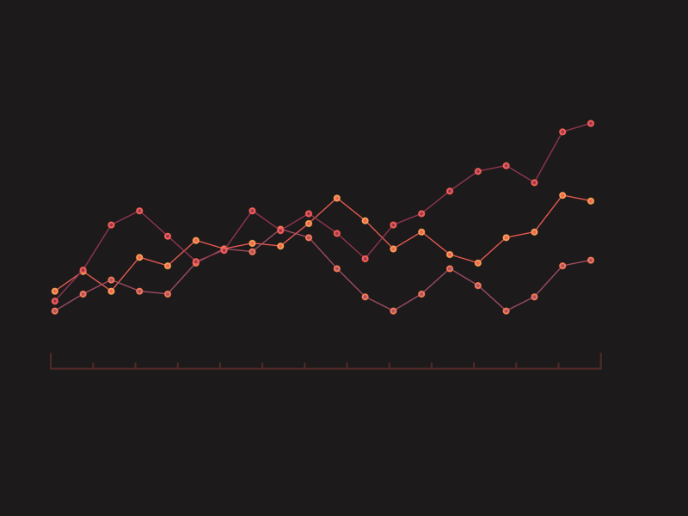
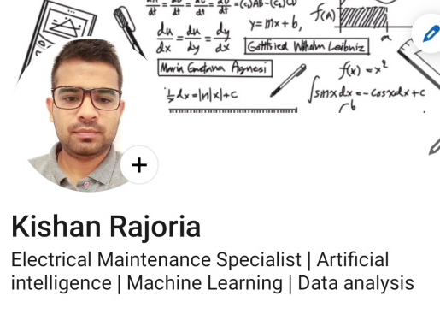
Time series analysis Energy (“KWH”)

Slide 2

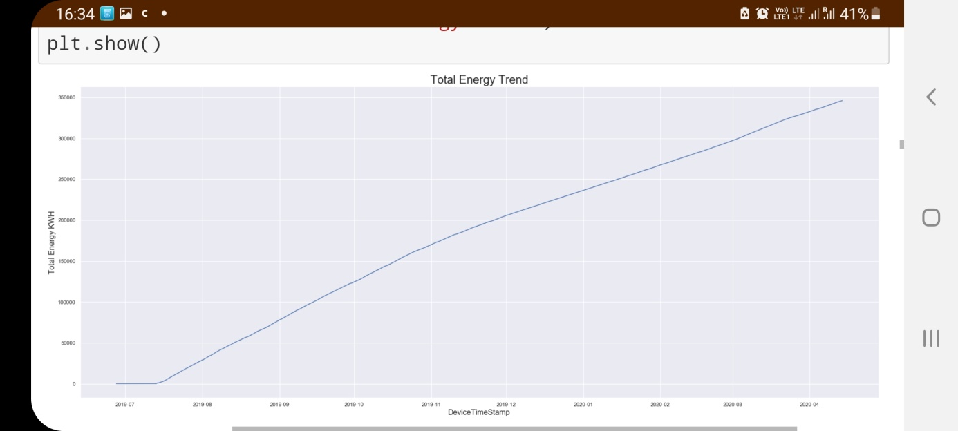
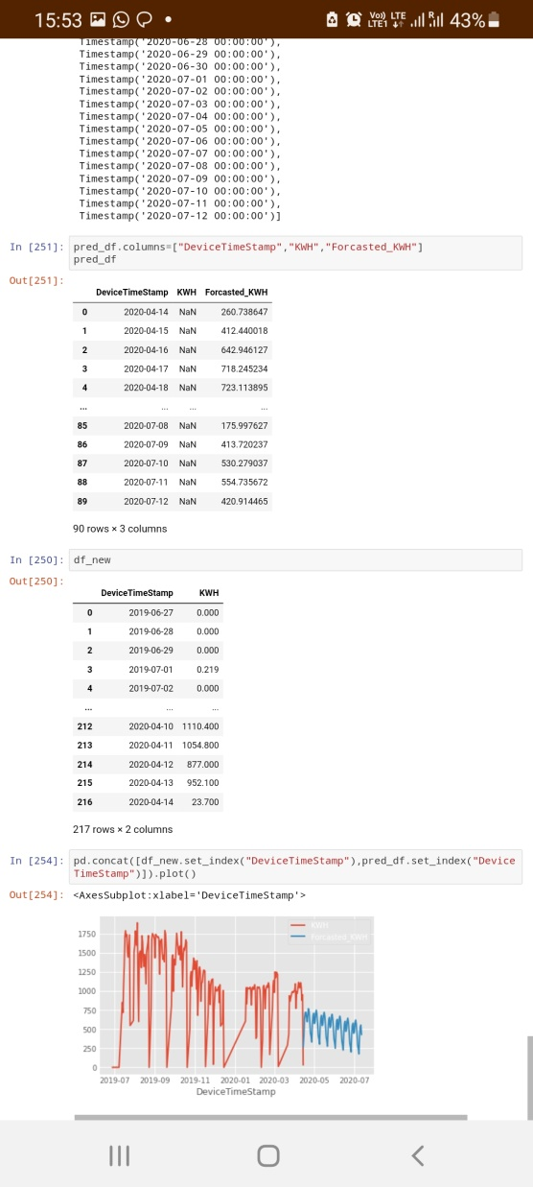
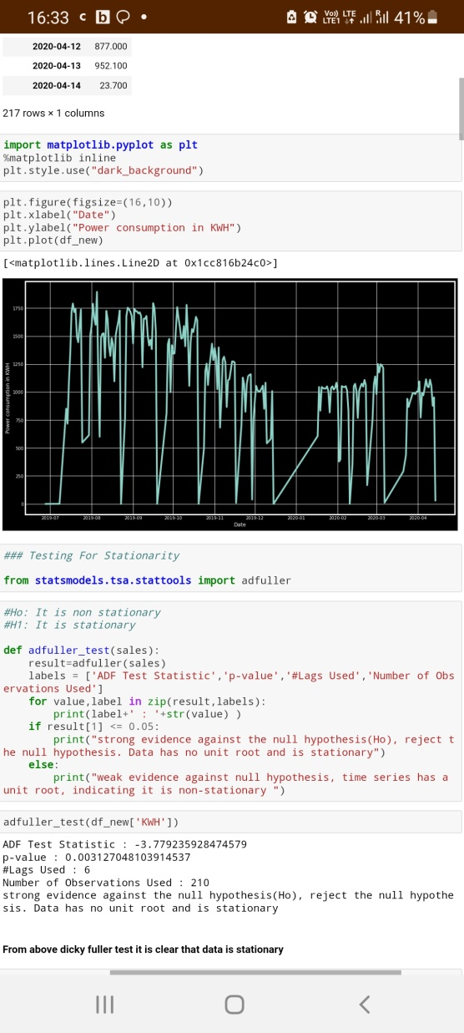
Forecasting of Billing Energy using ARIMA model:
Note:-
Here we are forecast Energy
Why: Energy is Power * time
Energy is related with Billing and it increase w.r.t time.
Billing is cost to the company.
There is pattern inside it.
Jul to Nov(Mid)
Nov to feb
Energy Forcasting (‘KWH’)

Slide 3
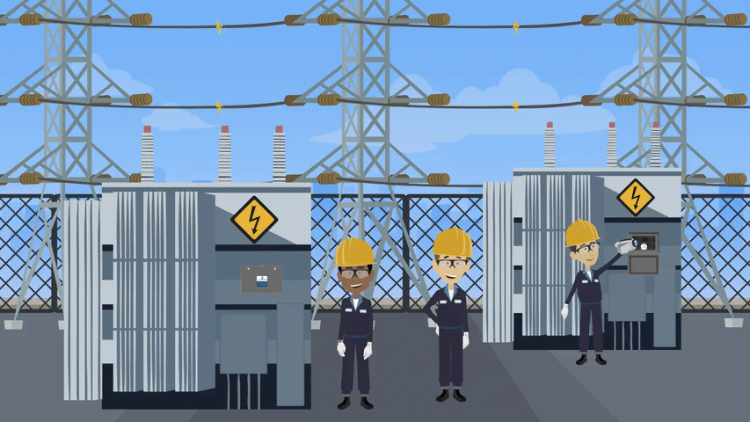
Power Stability issue transformer (oil type)

Slide 4
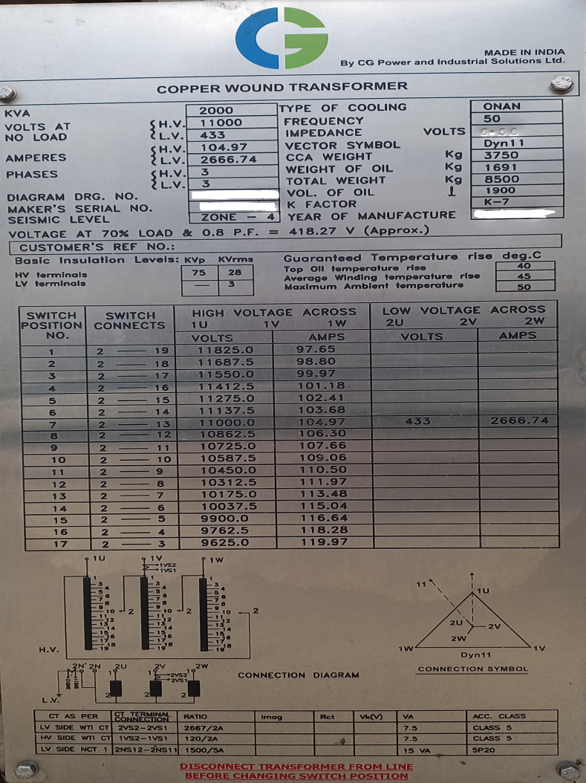
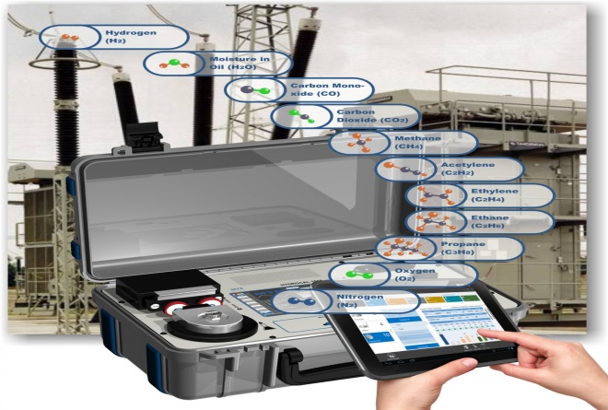
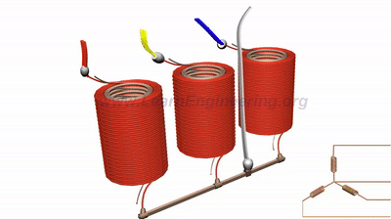
1. Target variables and independent variable:
Targeted Variables
Independent Variables
Amps (I2R losses, Heating, variation)
DGA value (Blood test)
Voltage
KVA
KW
HZ
Power Factor
Harmonics
WTI
OTI
Oil BDV
Power Stability issue transformer

Slide 5
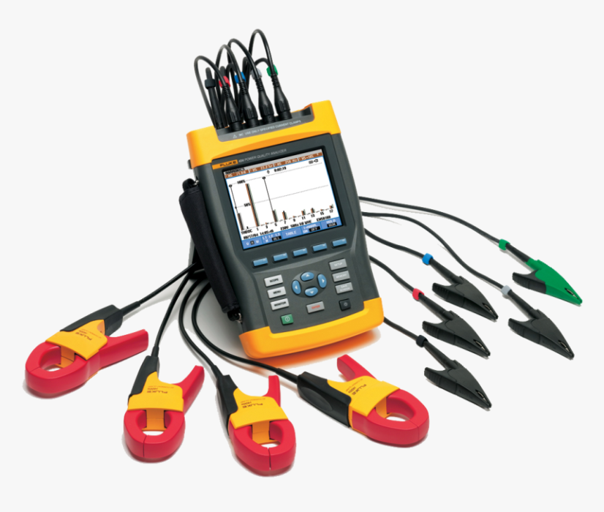
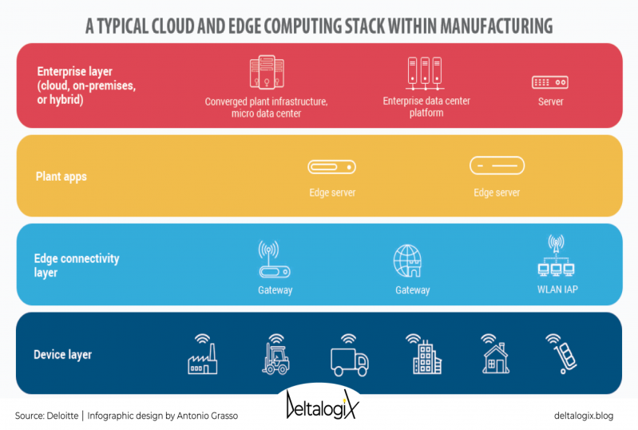
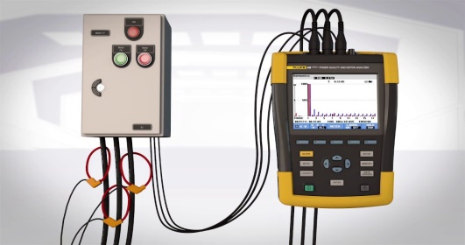
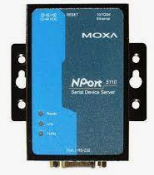
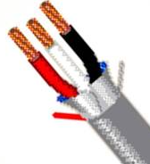
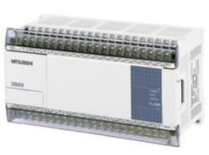
2. IoT sensors Installed for Variables collection
Power Analyser
REAL TIME VIEW
E
Current sensors measured the current from the feeder and store in power analyser
IL2
IL1
IL3
VL1
ILN
VLn
Voltage sensors measured the Voltage from the feeder and store in power analyser
VL2
VL3
Note:
Assumption: We are assuming that the data collection is to investigate stability issue. So this temporary and more flexible data collection technique.
Power Analyser itself calculate the remaining KWH, KWH_I, KVARH, KW, KVA, KVAR, MPD, MKVAD by Current and voltage sensor Data.
Moxa
Cable
PLC
KWH | KWH_I | KVARH | KW | KVA | KVAR | MPD | MKVAD
Kilo watt hour(Energy) | Kilo watt hour import | Reactive power hour | Kilo watt (Real Power) | Kilo volt Amp (apparent power) | Reactive power hour | Maximum power demand | Maximum Demand (In KVA)

Slide 6
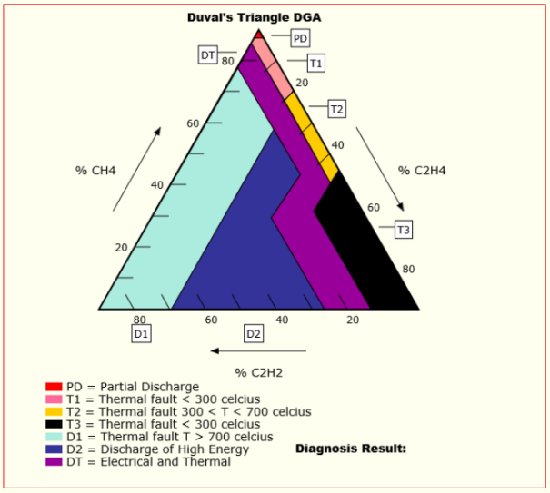
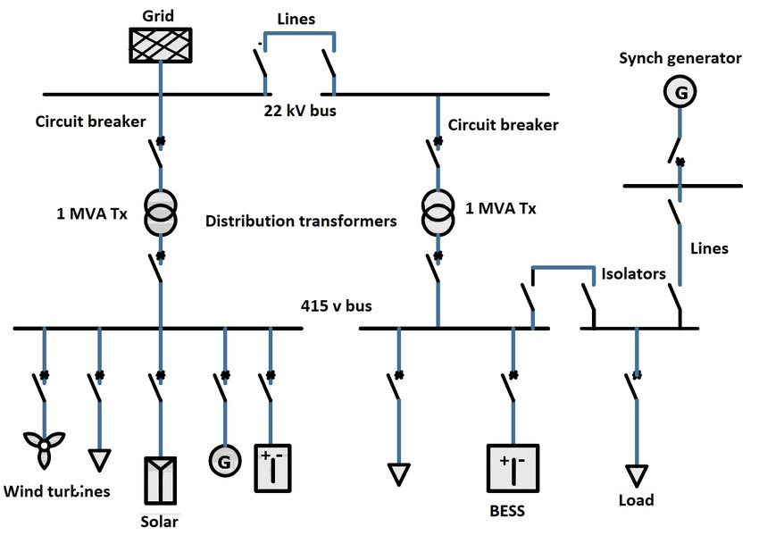
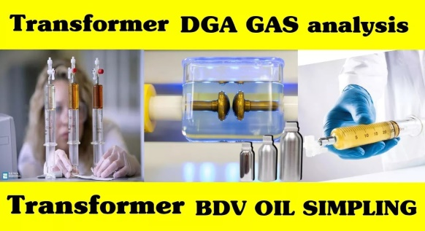
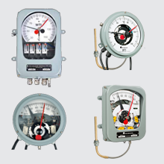
3. Amount of History data required
a) Power data: High priority
Date/ time | Voltage | Ampere | KW | KVA | KVAR | PF | Frequency | Max Demand | V thd | I thd | KWh | KVAH
All the above variable data we should go with max 4Weeks, 60samples per minutes data of working and No-working to analyse machine behaviour or load pattern. Note:- If stability issue is frequent then duration of that event data is very insightful.
b) DGA (Dissolve gas analysis): High Priority
Date/ time | CO | CO2 | CH4 | C2H2 | C2H4 | C2H6 | H2 | O2
All the above variable data DGA online monitoring or DGA testing report analyse using DOVAL triangle or Rogers ratio method.
c) Protection relays calibration data, Relays settings, Load shedding scheme:
d) Thermal image history, WTI, OTI, Oil BDV test and PM schedule:
e) Single line diagram of machine operation:

Slide 7
4. Data will be collected at what frequency
a) Power data: High priority
Date/ time | Voltage | Ampere | KW | KVA | KVAR | PF | Frequency | Max Demand | V thd | I thd | KWh | KVAH
All the above variable data we should 60samples per minutes data to catch small anomalies. Note:- If stability issue is frequent then duration of that event data is very insightful.
b) DGA (Dissolve gas analysis): High Priority
Date/ time | CO | CO2 | CH4 | C2H2 | C2H4 | C2H6 | H2 | O2
If Online DGA monitoring is not available, then oil sampling taken and do DGA testing. Latest One time sampling ok.
c) Protection relays calibration data, Relays settings, Load shedding scheme: O/V, E/F, O/C, Distance
protection, Bucholze relay, MOG relay setting data to be check.
d) Thermal image history, WTI, OTI, Oil BDV test and PM schedule: Latest thermal imaging records.
e) Single line diagram of machine operation: Updated connected loads detail associated with transformers.
Power Stability issue transformer

Slide 8
5. Deployment Architecture on cloud Environment
It is Methodology that provides services to provision and deliver resources via the internet. It help in reducing infrastructure management, cost, reduction and makes application, development and maintenance easy.
Customer responsibility in the cloud
Security
Data (KWH, KW, KVA………etc)
Platform, Application and access
Cloud responsibility of the cloud
Operating system, Network, Fire wall
Software
Customer side encryption
Server side encryption
Networking traffic
Compute
Storage
Database
Networking
Hardware –Infra structure
Region
Availability excess
Edge Location
Power Stability issue transformer

Slide 9
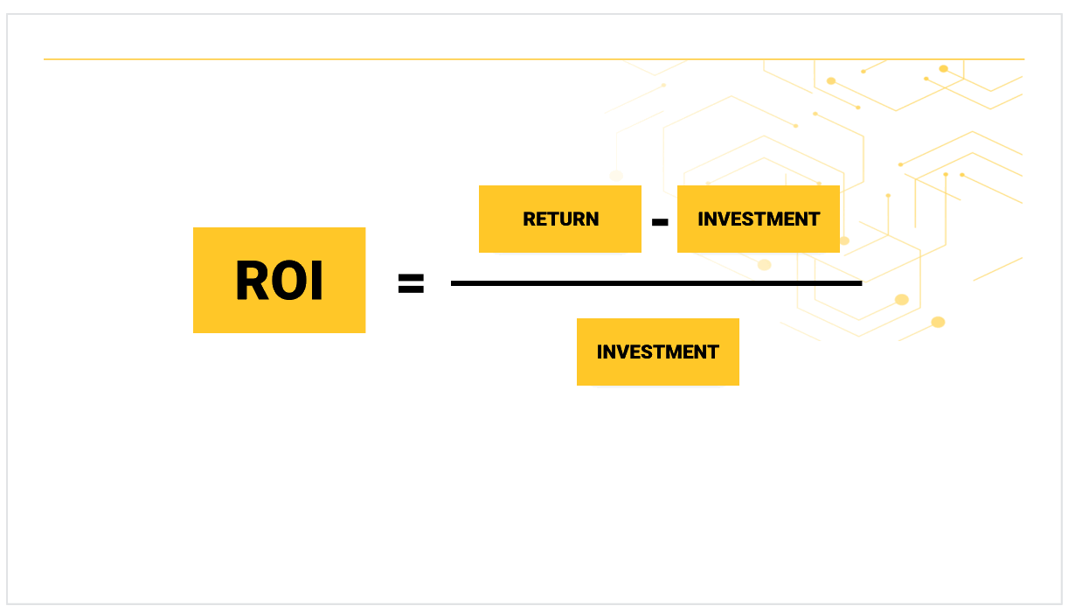
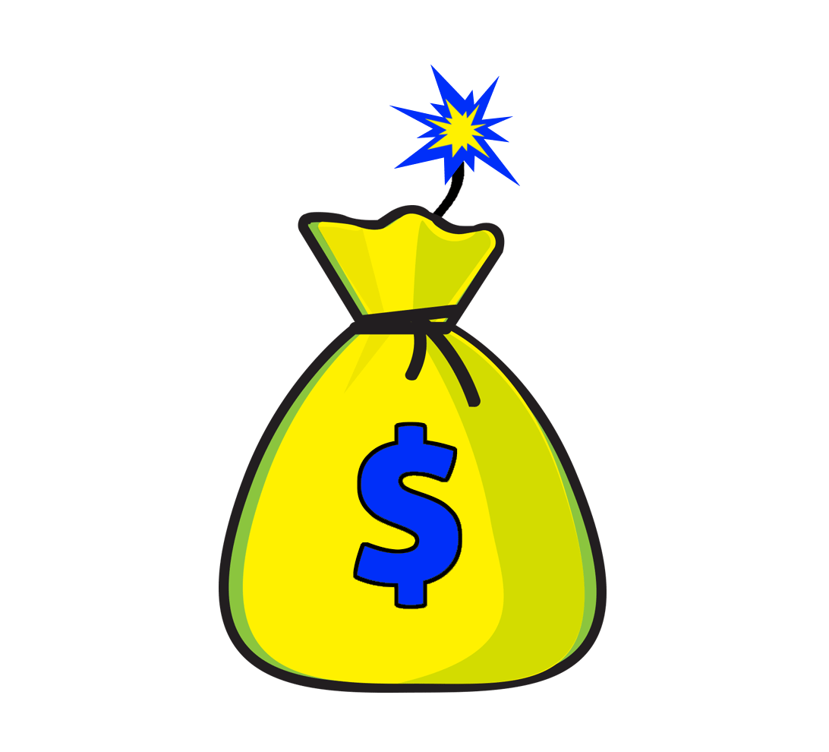
6. ROI and Impact this project
ROI:
Suppose
-Client investment: 300K$
-Our Expense (Man hour, Technology, field work, sensor etc): 200K$
-Net Profit: 100K$
-: ROI- (100K$/200K$)*100 = 50%
-: ROI- Reduce Breakdown and Machine UP time.
-: ROI- Customer Benefit
-: ROI- Machine efficiency
Power Stability issue transformer

Slide 10



7. Fore See Risk involved
Technology risk: Data security, compliance, personal training, service outage, project failure.
Communication Risk: Setting Up meetings, track changes, loss of data or misinformation.
Cost risk and Scope risk: Low Scope-Low Cost, High scope-High Cost.
Health and safety risk: Pandemic, Team Health
Risk Mitigation Plan:
Identify the risk, risk register(What technology customer end, Man support from client side, Customer Data sharing policy, Customer Working compliance, any machine breakdown, pandemic risk)
Prioritize the risk, track the risk during task execution (Assigning task, support for tech and extra skill required, daily updates)
Impact and response of the risk (Upstanding project and PPA, daily meeting, follow all covid guidelines)
Power Stability issue transformer

Slide 11

8. Guidance and Knowledge transfer
Day to Day operational activity up to the end of project
Electrical Engineering methods, tools.
Concept of understanding transformer data, data variables.
DGA, Oil BD, Electrical Parameters, Electrical Transformers, SLD
Other technical and required skill sets
Covid safety guidelines and dicipline
Power Stability issue transformer

